Slide 1
AZ-100.4 Configuring and Managing Virtual Networks

Slide 2
Course Agenda
M01: Azure Virtual Networks
L01: Introducing Virtual Networks
L02: Creating Azure Virtual Networks
L03: Review of IP Addressing
L04: Network Routing
M02: Azure DNS
L01: Azure DNS Basics
L02: Implementing Azure DNS
M03: Securing Virtual Network Resources
L01: Introduction to Network Security Groups
L02: Implementing Network Security Groups and Service Endpoints
M04: Connecting Virtual Networks
L01: Intersite Connectivity
L02: Virtual Network Peering

Slide 3
AZ-100.4 Module 01: Azure Virtual Networks

Slide 4
Lesson 01: Introducing Virtual Networks

Slide 5
Basic Azure Virtual Networking Concepts
What Azure locations will you use to host VNets?
Do you need communications between these Azure locations?
How many IaaS VMs, cloud service roles, and web apps do you need?
Do you need to isolate traffic based on groups of VMs?
Do you need to control traffic flow using virtual appliances?
Do users need different sets of permissions to different Azure resources?

Slide 6
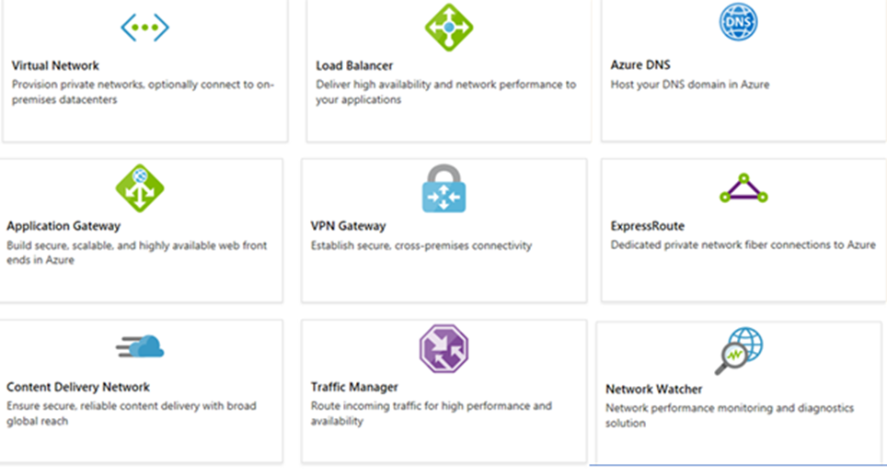
Introduction to Azure Networking Components
Adopting cloud solutions can save time and simplify operations
Azure requires the same types of networking functionality as on-premises infrastructure
Azure networking offers a wide range of services and products
Notes:
Take a minute to review each component. There is a module review question on this.
For more information, you can see:
Azure Virtual Networks - https://azure.microsoft.com/en-us/services/virtual-network/

Slide 7
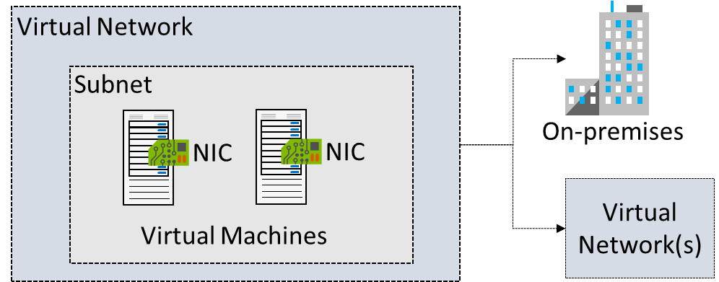
Virtual Networks
Logical representation of your own network
Create a dedicated private cloud-only VNet
Securely extend your datacenter With VNets
Enable hybrid cloud scenarios
Notes:
For more information, you can see:
What is an Azure virtual network? - https://docs.microsoft.com/en-us/azure/virtual-network/virtual-networks-faq#what-is-an-azure-virtual-network-vnet

Slide 8
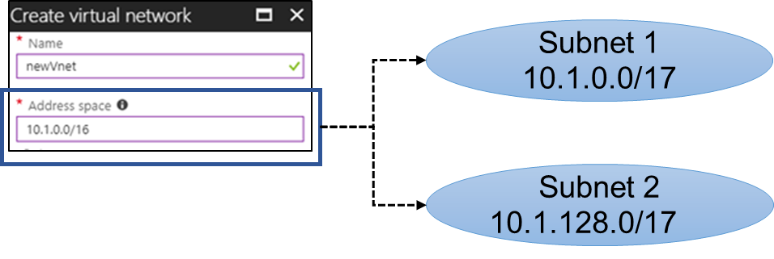
Subnets
A virtual network can be segmented into one or more subnets
Subnets provide logical divisions within your network
Subnets can help improve security, increase performance, and make it easier to manage the network
Notes:
Generally, discuss service requirements and virtual appliances.
✔️ Azure reserves the first three IP addresses and the last IP address in each subnet address range.
✔️ The Review of IP Addressing lesson covers the basics of IP addressing if you need a refresher.
For more information, you can see:
Subnets - https://docs.microsoft.com/en-us/azure/virtual-network/virtual-network-VNet-plan-design-arm#subnets
Services that can be deployed into a virtual network - https://docs.microsoft.com/en-us/azure/virtual-network/virtual-network-for-azure-services#services-that-can-be-deployed-into-a-virtual-network

Slide 9
Managing Virtual Networks (Common Tasks)
Creating a virtual network
Viewing virtual networks and settings
Adding and removing address spaces
Adding and changing a DNS server
Deleting a virtual network
Notes:
Managing Virtual Networks (Common Tasks) - https://www.youtube.com/embed/zIX6ofSpc2U

Slide 10
Lab 1A: Virtual Networks
Create a virtual network
Create virtual machines
Connect to a VM from the internet
Communicate between VMs
Notes:
Virtual Networks Practice - https://docs.microsoft.com/en-us/azure/virtual-network/quick-create-portal

Slide 11
Lesson 02: Creating Azure Virtual Networks

Slide 12
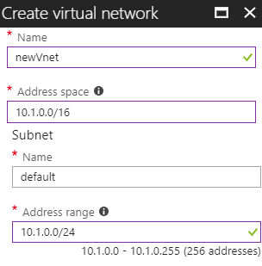
Implementing Virtual Networks
Create new virtual networks at any time
Add virtual networks when you create a virtual machine
Need to define the address space, and at least one subnet
Be careful with overlapping address spaces
Notes:
✔️ Always plan to use an address space that is not already in use in your organization, either on-premises or in other VNets. Even if you plan for a VNet to be cloud-only, you may want to make a VPN connection to it later. If there is any overlap in address spaces at that point, you will have to reconfigure or recreate the VNet. The next lesson will focus on IP addressing.
For more information, you can see:
What is Azure Virtual Network - https://docs.microsoft.com/en-us/azure/virtual-network/virtual-networks-overview
Networking Limits - https://docs.microsoft.com/en-us/azure/azure-subscription-service-limits#networking-limits-1

Slide 13
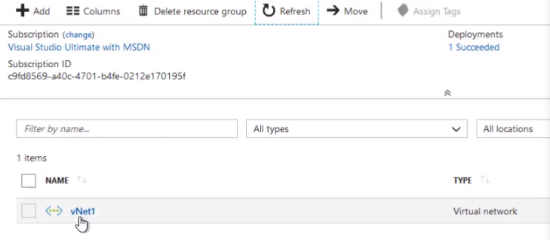
Virtual Networks (Portal)
Notes:
Virtual Networks (Portal) - https://www.youtube.com/embed/uJqpzDVcT3Q

Slide 14
Virtual Networks (PowerShell and CLI)
CLI
az network vnet create –resource-group “networking” –name “clilNet” –address-prefixes “9.0.0.0/8” –subnet-name “subnet1” –subnet-prefix “9.1.0.0/16”
PowerShell
$subnet = New-AzureRMVirtualNetworkSubnetConfig –Name “Subnet1” –AddressPrefix “8.1.0.0/16”
New-AzureRMVirtualNetwork –Name “psNet” –ResourceGroupName “Networking” –Location EastUS –AddressPrefix “8.0.0.0/8” –Subnet $subnet
Notes:
In this video Corey mentions the Unified Client. He is referring to the Azure Command Line Interface (CLI).

Slide 15
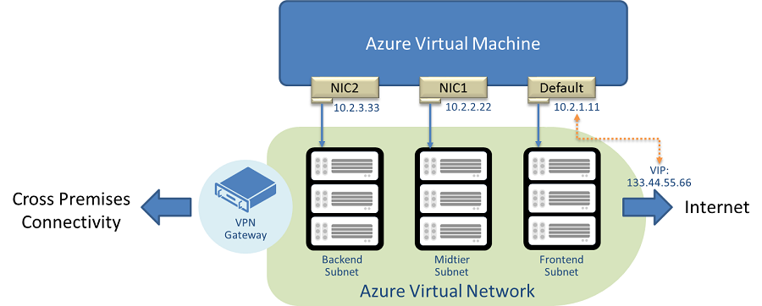
Multiple NICs in Virtual Machines
You can create virtual machines with multiple NICs
Useful for virtual appliances, network traffic management, and isolation of traffic
The VM size determines the number of NICs that can be supported
Once deployed can’t change from single to multiple
Notes:
For more information, you can see:
Add network interfaces to or remove network interfaces from virtual machines - https://docs.microsoft.com/en-us/azure/virtual-network/virtual-network-network-interface-vm

Slide 16
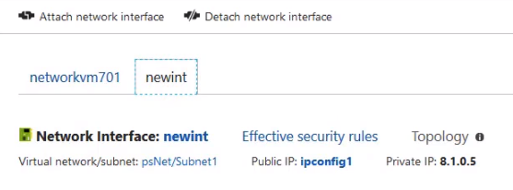
Using Multiple NICs
You must deallocate the virtual machine to make NIC changes
The primary NIC has the default gateway address
Verify the configuration by connecting the virtual machine
Notes:
Using Multiple NICs - https://www.youtube.com/embed/hEpW6-TmdXk
For more information, see:
Create and manage a Windows virtual machine that has multiple NICs - https://docs.microsoft.com/en-us/azure/virtual-machines/windows/multiple-nics

Slide 17
Lesson 03: Review of IP Addressing

Slide 18
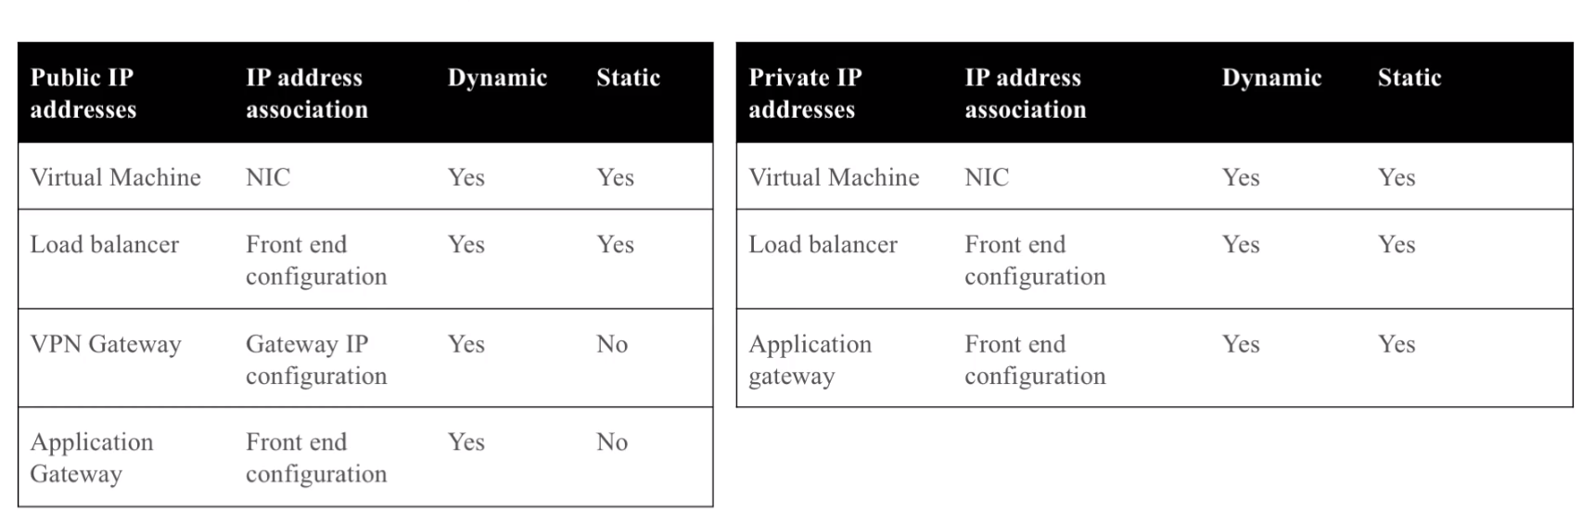
IP Addressing
Notes:
IP Addressing - https://www.youtube.com/embed/FWIgU0yhM4o

Slide 19
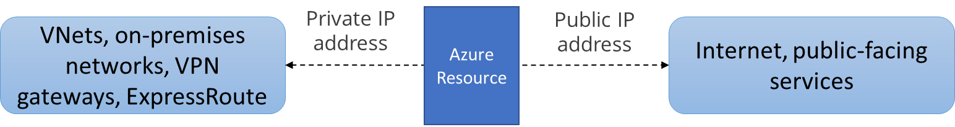
Private and Public IP Addresses
Private IP addresses are used for communication within an Azure virtual network (VNet), and your on-premises network, when you use a VPN gateway or ExpressRoute circuit to extend your network to Azure.
Public IP addresses is used for communication with the Internet, including Azure public-facing services.
Notes:
✔️ As a best practice you may decide to separate dynamically and statically assigned IP resources into different subnets. And, IP Addresses are never managed from within a virtual machine.

Slide 20
Static vs Dynamic Addressing
IP addresses can be statically or dynamically assigned
Static IP addresses do not change and are best for:
DNS name resolution, where a change in the IP address would require updating host records
IP address-based security models which require apps or services to have a static IP address
SSL certificates linked to an IP address
Firewall rules that allow or deny traffic using IP address ranges
Role-based VMs such as Domain Controllers and DNS servers

Slide 21
Public IP Addresses
Public IP addresses | IP address association | Dynamic | Static
Virtual Machine | NIC | Yes | Yes
Load Balancer | Front-end configuration | Yes | Yes
VPN Gateway | Gateway IP configuration | Yes | No
Application Gateway | Front-end configuration | Yes | No
A public IP address resource can be associated with virtual machine network interfaces, internet-facing load balancers, VPN gateways, and application gateways.
Notes:
For more information, you can see:
Public IP addresses - https://docs.microsoft.com/en-us/azure/virtual-network/virtual-network-ip-addresses-overview-arm#public-ip-addresses

Slide 22
Basic vs Standard SKUs
Feature | Basic SKU | Standard SKU
IP assignment | Static or dynamic | Static
Security | Open by default | Are secure by default and closed to inbound traffic
Resources | Network interfaces, VPN Gateways, Application Gateways, and Internet-facing load balancers | Network interfaces or public standard load balancers
Redundancy | Not zone redundant | Zone redundant by default
Make the SKU selection when you create the public IP address
Notes:
For more information, you can see:
Allocation method - https://docs.microsoft.com/en-us/azure/virtual-network/virtual-network-ip-addresses-overview-arm#allocation-method

Slide 23
Private IP Addresses
Private IP Addresses | IP address association | Dynamic | Static
Virtual Machine | NIC | Yes | Yes
Internal Load Balancer | Front-end configuration | Yes | Yes
Application Gateway | Front-end configuration | Yes | Yes
Dynamic (default). Azure assigns the next available unassigned or unreserved IP address in the subnet's address range
Static. You select and assign any unassigned or unreserved IP address in the subnet's address range
Notes:
For more information, you can see:
Private IP addresses - https://docs.microsoft.com/en-us/azure/virtual-network/virtual-network-ip-addresses-overview-arm#private-ip-addresses

Slide 24
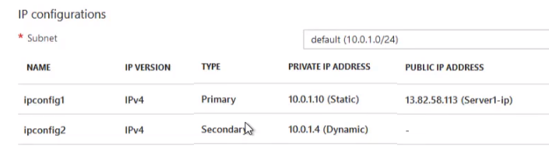
Configuring IP Settings
If public IP addresses are optional, how will you manage the virtual machine?
In the Azure portal, IP configurations are managed on the network interface not within the virtual machine.
Changes to the network interface may result in a virtual machine restart.
Notes:
Configuring IP Settings - https://www.youtube.com/embed/v2lLnIR55Ng

Slide 25
Lesson 04: Network Routing

Slide 26
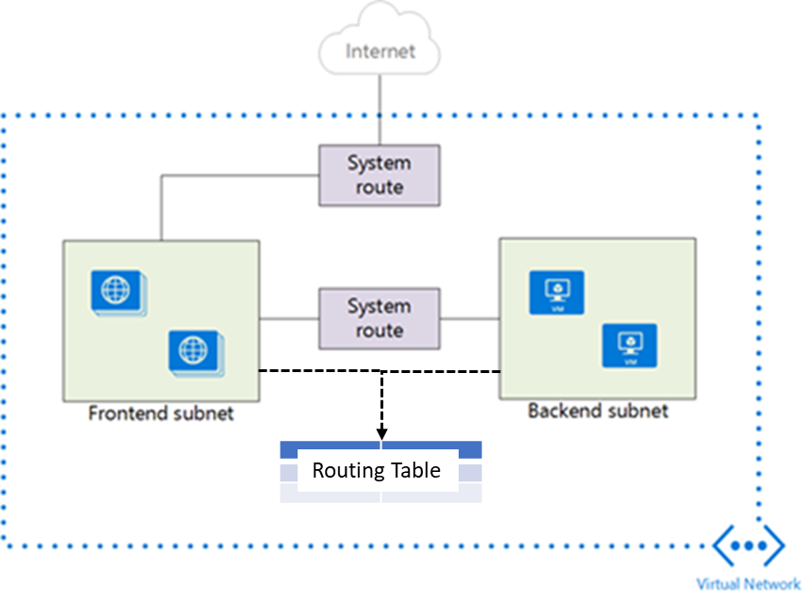
System Routes
System routes direct network traffic between virtual machines, on-premises networks, and the Internet
Traffic between VMs in the same subnet
Between VMs in different subnets in the same virtual network
Data flow from VMs to the Internet
Communication between VMs using a VNet-to-VNet VPN
Site-to-Site and ExpressRoute communication through the VPN gateway
Notes:
For more information, you can see:
System routes - https://docs.microsoft.com/en-us/azure/virtual-network/virtual-networks-udr-overview#system-routes

Slide 27
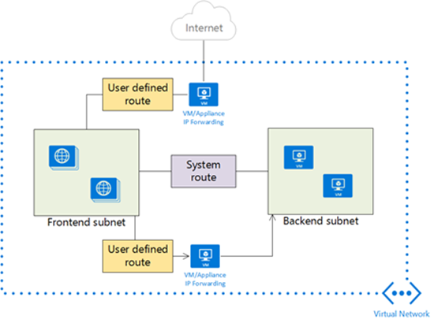
User Defined Routes
A route table contains a set of rules, called routes, that specifies how packets should be routed in a virtual network
User-defined routes are custom routes that control network traffic by defining routes that specify the next hop of the traffic flow
The next hop can be a virtual network gateway, virtual network, internet, or virtual appliance
Notes:
✔ Each route table can be associated to multiple subnets, but a subnet can only be associated to a single route table. There are no additional charges for creating route tables in Microsoft Azure. Do you think you will need to create custom routes?
For more information, you can see:
Custom routes - https://docs.microsoft.com/en-us/azure/virtual-network/virtual-networks-udr-overview#custom-routes

Slide 28
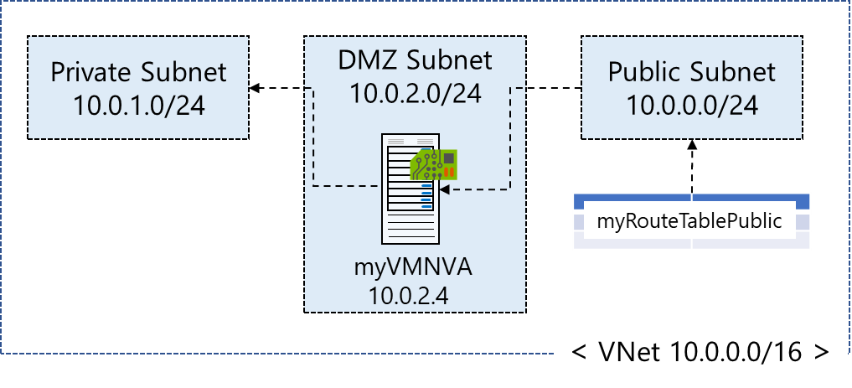
Routing Example
Create the route table
Create the route
Associate the route to the subnet
Notes:
✔️ There is practice exercise that includes a complete set of steps for this scenario, including creating the virtual appliance and testing. The next three slides implement this specific example.

Slide 29
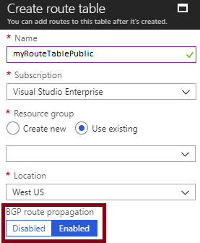
1. Create Route Table (BGP)
BGP is a standard routing protocol used to exchange routing and reachability information between two or more networks
Routes are automatically added to the route table of all subnets with BGP propagation enabled
In most situations you will want to enable BGP route propagation
Notes:
There is an upcoming video on BGP for VPN.
For more information, you can see:
Border gateway protocol - https://docs.microsoft.com/en-us/azure/virtual-network/virtual-networks-udr-overview#border-gateway-protocol
Overview of BGP with Azure VPN Gateways - https://docs.microsoft.com/en-us/azure/vpn-gateway/vpn-gateway-bgp-overview?toc=%2fazure%2fvirtual-network%2ftoc.json

Slide 30
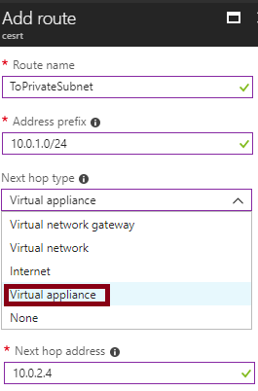
2. Create the Route
When you create a route there are several Next hop types
In this example, any private subnet IP addresses will be sent to the virtual appliance
Other choices are Virtual network gateway, Virtual network, Internet, and None

Slide 31
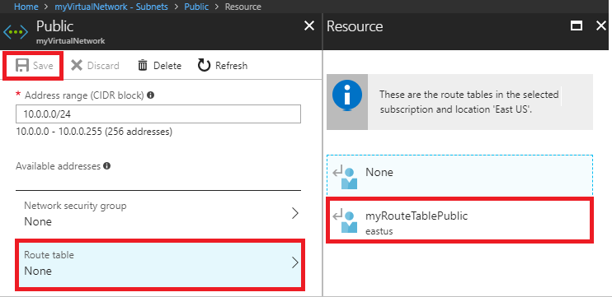
3. Associate Route to Subnet
Each subnet can have zero or one route table associated to it
In our example, the Public subnet will be associated with the routing table
Notes:
✔️ In this case the virtual appliance should not have a public IP address and IP forwarding should be enabled. Be sure to try the practice.

Slide 32
Routing Algorithms (Longest prefix match)
Source | Address prefixes | Next hop type
System | 10.0.0.0/24 | Internet (selected)
System | 10.0.0.0/16 | Virtual network gateway
What if a destination address matches two routes in the routing table?
Azure selects a route using the longest prefix match algorithm, which is the 10.0.0.0/24 route.

Slide 33
Routing Algorithms (Route priorities)
Source | Address prefixes | Next hop type
User | 10.0.0.0/16 | Internet (selected)
System | 10.0.0.0/16 | Virtual network gateway
When the address prefixes are the same, Azure selects the route type, based on priority:
User-defined route
BGP route
System route
Notes:
Routing algorithms are important for troubleshooting.
For more information, you can see:
How Azure selects a route - https://docs.microsoft.com/en-us/azure/virtual-network/virtual-networks-udr-overview#how-azure-selects-a-route

Slide 34
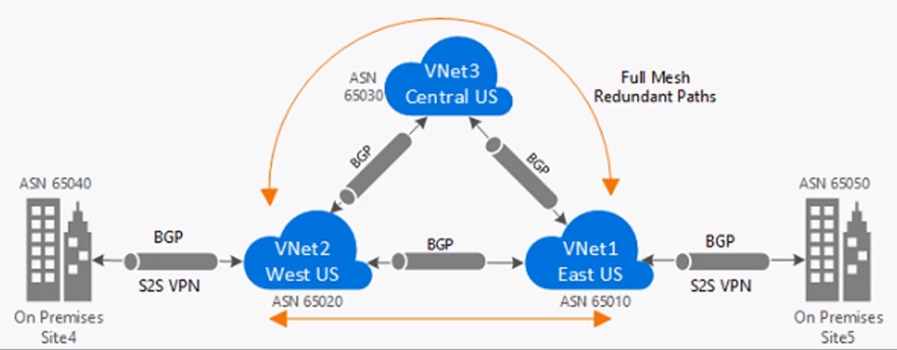
Video: BGP for VPN
Notes:
BGP for VPN - https://channel9.msdn.com/Series/Azure-Hybrid-Network/BGP-for-VPN-Part-1-BGP-Routing-for-Azure-VPN-Gateways/player

Slide 35
Lab 1B: Routing
Create a route table
Create a route
Create a virtual network with multiple subnets
Associate a route table to a subnet
Create an NVA that routes traffic
Deploy virtual machines (VM) into different subnets
Route traffic from one subnet to another through an NVA
More complicated Routing example
Create, change, or delete a route table
Notes:
Practice: Routing - https://docs.microsoft.com/en-us/azure/virtual-network/tutorial-create-route-table-portal
More complicated routing example – https://docs.microsoft.com/en-us/azure/virtual-network/virtual-networks-udr-overview#routing-example
Create, change, or delete a route table - https://docs.microsoft.com/en-us/azure/virtual-network/manage-route-table#associate-a-route-table-to-a-subnet

Slide 36
AZ-100.4 Module 02: Azure DNS

Slide 37
Lesson 01: Azure DNS Basics

Slide 38
Name Resolution in Azure Virtual Networks
Scenario | Location | Name Resolution Provision
Between VMs and IaaS v2 | Same VNet | Use Azure provide name resolution or bring your own DNS
Between role instances or VMs | Same VNet but different cloud services | Use your own DNS implementation. For FQDN resolution you can use Azure name resolution for the first 100 cloud services
Between VMs or role instances and on-premises computers | Azure VNets and on-premises | Use your own DNS server/DNS implementation
Between VMs | Different VNets | Use your own DNS server/DNS implementation
Between on-premises computers and public endpoints | On-premises to Azure | Use Azure external name resolution
Reverse lookup or internal IP address | Azure VNet | Use your own DNS server/DNS implementation
Notes:
Name Resolution in Azure VNets - https://www.youtube.com/embed/ScgFVprA8wE

Slide 39
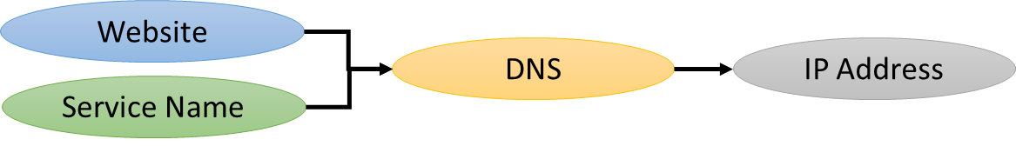
Azure DNS Benefits
DNS is a hosting service for DNS domains
DNS provides name resolution by resolving a website or service name to its IP address
Azure DNS is global with fast performance and high availability
Scales and updates records quickly
Notes:
✔️ Have you thought about using Azure for your DNS needs?
For more information, you can see:
Azure DNS - https://azure.microsoft.com/en-us/services/dns/
What is DNS? - https://docs.microsoft.com/en-us/azure/dns/dns-overview
Azure DNS FAQ - https://docs.microsoft.com/en-us/azure/dns/dns-faq

Slide 40
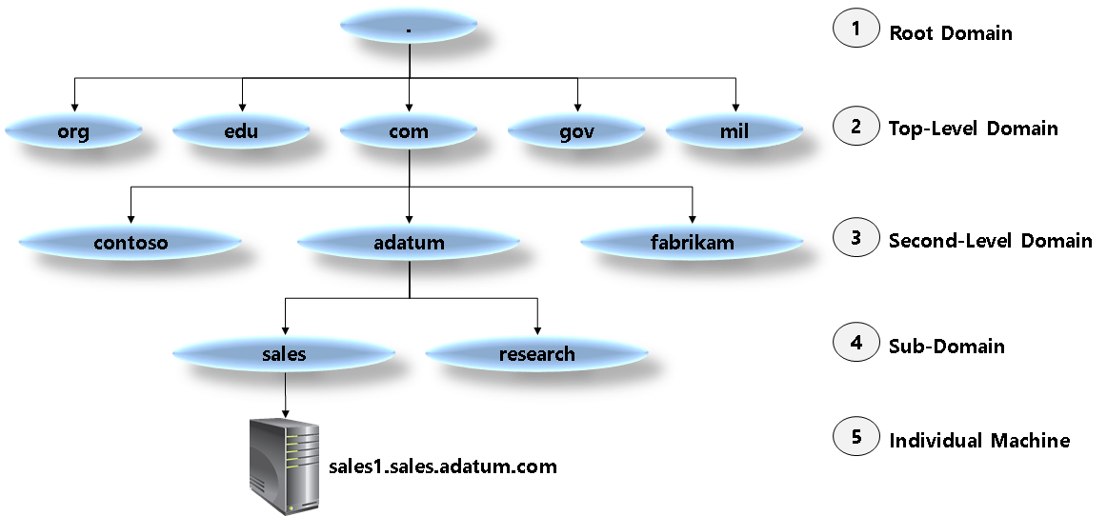
DNS Domains
Azure DNS does not currently support purchasing of domain names
Notes:
✔️ Azure DNS does not currently support purchasing of domain names. If you want to purchase domains, you'll need to use a third-party domain name registrar. The registrar will typically charge a small annual fee. Purchasing a domain name gives you the right to control the DNS hierarchy under that name. For example, allowing you to direct the name 'www.contoso.com' to your company web site.
For more information, you can see:
Domain Names - https://docs.microsoft.com/en-us/azure/dns/dns-zones-records#domain-names

Slide 41
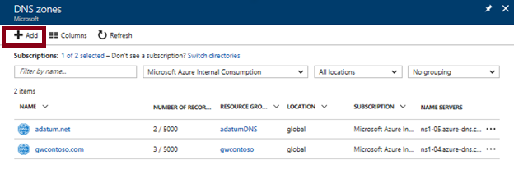
DNS Zones
A DNS zone hosts the DNS records for a domain
The name of the zone must be unique within the resource group
Where multiple zones share the same name, each instance is assigned different name server addresses
Only one set of addresses can be configured with the domain name registrar
Notes:
✔️ You do not have to own a domain name to create a DNS zone with that domain name in Azure DNS. However, you do need to own the domain to configure the domain.
For more information, you can see:
DNS Zones - https://docs.microsoft.com/en-us/azure/dns/dns-zones-records#dns-zones

Slide 42
DNS Record Types
An Azure DNS zone can support all common DNS record types
Record Type | Full Name | Function
A (IPv4) AAAA (IPv6) | Address | Maps a host name such as mail.adatum.com to an IP address
CNAME | Canonical name | Points one host record, such as adatum.ftp.adatum.com, to another host record, such as mail.lucernepublishing.com, or even another host record in another domain, such as www.contoso.com.
MX | Mail exchange | Points to the host that will receive mail for that domain. MX records must point to an A record, not to a CNAME record.
NS | Name server | Delegates a DNS zone to the specified authoritative name server.
SOA | Start of Authority | Defines the authoritative record for the zone.
SRV | Service | Locates hosts that are providing specific services, such as the Session Initiation Protocol (SIP) endpoint.
TXT | Text | Records a human-readable text field in DNS.
Notes:
For more information, you can see:
DNS record names - https://docs.microsoft.com/en-us/azure/dns/dns-zones-records#record-names
DNS record types - https://docs.microsoft.com/en-us/azure/dns/dns-zones-records#record-types

Slide 43
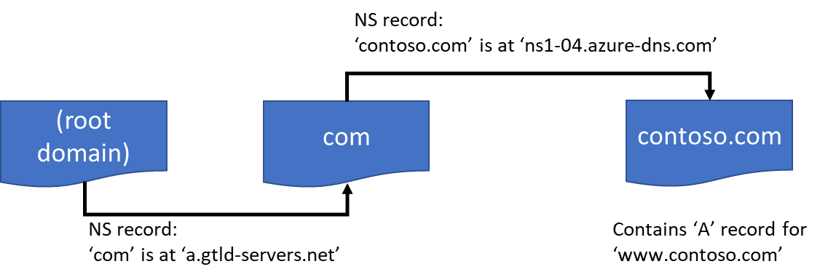
DNS Resolution
Azure DNS provides an authoritative DNS service for domain name resolution - the process by which a computer name is resolved to an IP address
Notes:
For more information, you can see:
Resolution and delegation - https://docs.microsoft.com/en-us/azure/dns/dns-domain-delegation#resolution-and-delegation

Slide 44
Lab 2A: DNS Zones
Create a DNS zone
List DNS zones
Delete a DNS zone
✔️ Use the reference links for PowerShell and CLI tasks.
Notes:
How to manage DNS zones - https://docs.microsoft.com/en-us/azure/dns/dns-operations-dnszones-portal
For more information, you can see:
How to manage DNS Zones using PowerShell - https://docs.microsoft.com/en-us/azure/dns/dns-operations-dnszones
How to manage DNS Zones in Azure DNS using the Azure CLI 2.0 - https://docs.microsoft.com/en-us/azure/dns/dns-operations-dnszones-cli

Slide 45
Lab 2B: DNS Records and Record Sets
View a record set.
Add a new record to a record set.
Update a record.
Remove a record from a record set.
Delete a record set.
Work with Name Server and SOA records.
Notes:
DNS Records and Record Sets - https://docs.microsoft.com/en-us/azure/dns/dns-operations-recordsets-portal
For more information, you can see:
Manage DNS records and record sets in Azure DNS using Azure PowerShell- https://docs.microsoft.com/en-us/azure/dns/dns-operations-recordsets
Manage DNS records and record sets in Azure DNS using the Azure CLI 2.0 – https://docs.microsoft.com/en-us/azure/dns/dns-operations-recordsets-cli

Slide 46
Lesson 02: Implementing Azure DNS

Slide 47
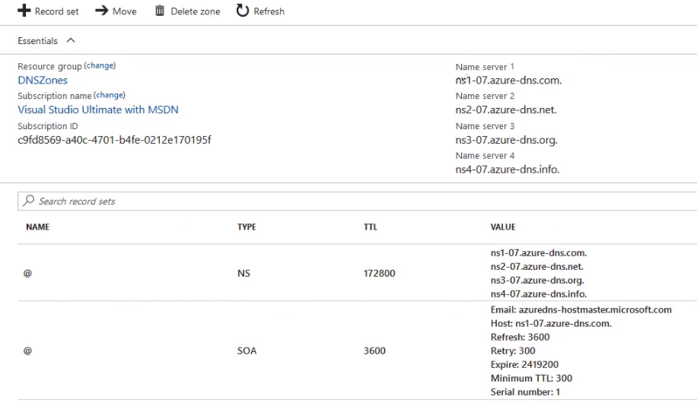
Azure DNS
Notes:
Azure DNS - https://www.youtube.com/embed/rF5ydqr8yIE

Slide 48
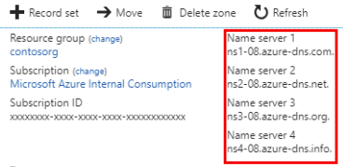
DNS Delegation
When delegating a domain to Azure DNS, you must use the name server names provided by Azure DNS
You should always use all four name server names
Once the DNS zone is created, and you have the name servers, you need to update the parent registrar
Notes:
The PowerShell slide is coming up.

Slide 49
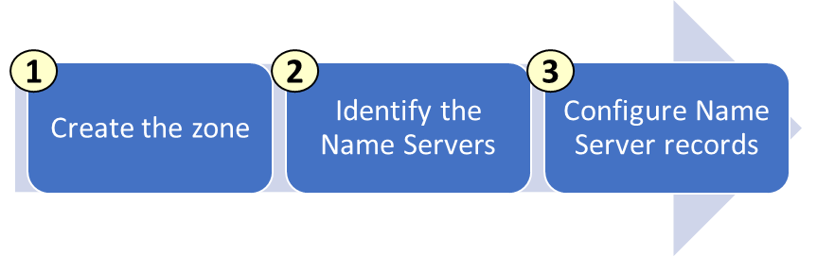
Delegating Sub-Domains
If you want to set up a separate child zone, you can delegate a sub-domain in Azure DNS
Same process, except the NS records are created in the Azure parent domain
Notes:
The PowerShell delegation slide is next.

Slide 50
Delegation (PowerShell)
# Retrieve the zone information
$zone = Get-AzureRmDnsZone –Name contoso.net –ResourceGroupName MyResourceGroup
# Retrieve the name server records
Get-AzureRmDnsRecordSet –Name “@” –RecordType NS –Zone $zone
# Create the parent zone
$parent = New-AzureRmDnsZone -Name contoso.com -ResourceGroupName RG1
# Create the child zone
$child = New-AzureRmDnsZone -Name partners.contoso.com -ResourceGroupName RG1
# Retrieve NS records for the child zone
$child_ns_recordset = Get-AzureRmDnsRecordSet -Zone $child -Name "@" -RecordType NS
# Create the NS record set in the parent zone.
$parent_ns_recordset = New-AzureRmDnsRecordSet -Zone $parent -Name "partners" - RecordType NS -Ttl 3600
$parent_ns_recordset.Records = $child_ns_recordset.Records
Set-AzureRmDnsRecordSet -RecordSet $parent_ns_recordset
Notes:
Take time to go through the commands and parameters.

Slide 51
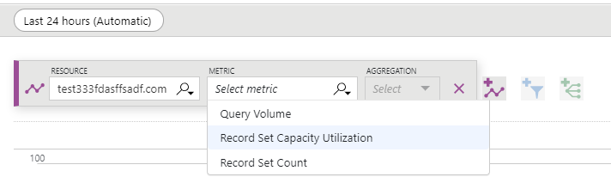
DNS Metrics and Alerts
Azure DNS provides metrics, so you can monitor the DNS zones
Query Volume – Volume of DNS queries
Record Set Capacity Utilization - Percentage of utilization of your Record set capacity
Record Set Count - The number of Record sets
Notes:
✔️Azure Monitor provides the capability to alert against available metric values.
For more information, you can see:
Azure DNS metrics and alerts - https://docs.microsoft.com/en-us/azure/dns/dns-alerts-metrics

Slide 52
AZ-100.4 Module 03: Securing Virtual Network Resources

Slide 53
Lesson 01: Introduction to Network Security Groups

Slide 54
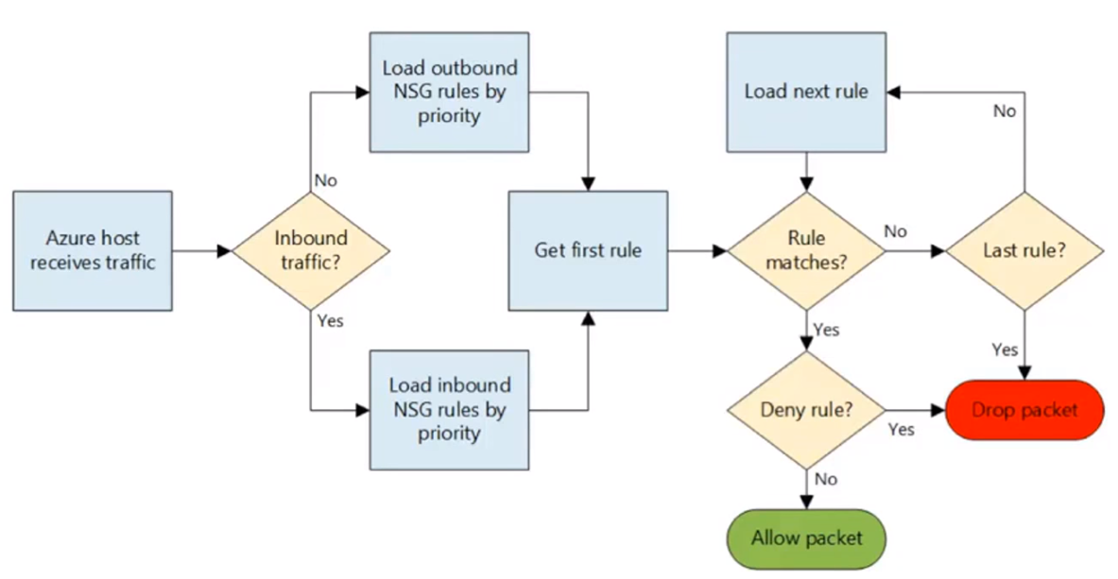
Understanding Network Security Groups
Notes:
Network Security Groups - https://www.youtube.com/embed/-wgtgWF-Bps

Slide 55
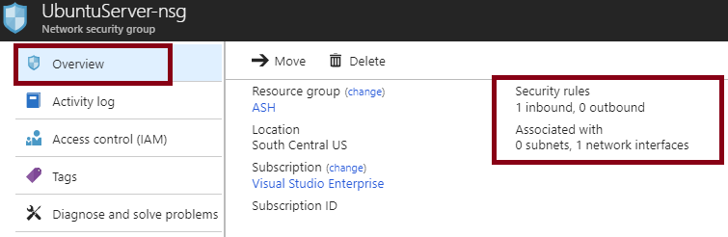
Overview of Network Security Groups
You can limit network traffic to resources in a virtual network using a network security group (NSG)
A network security group contains a list of security rules that allow or deny inbound or outbound network traffic
An NSG can be associated to a subnet or a network interface
Notes:
✔️ To simplify management of security rules, it's recommended that you associate a network security group to individual subnets, rather than individual network interfaces within the subnet.
For more information, you can see:
Network Security Groups - https://docs.microsoft.com/en-us/azure/virtual-network/security-overview#network-security-groups

Slide 56
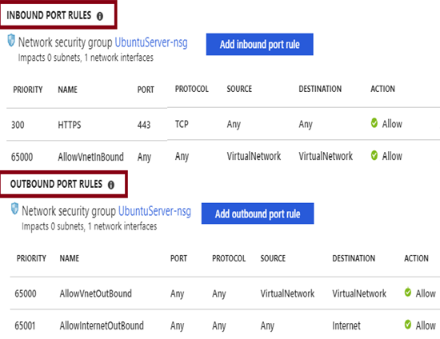
NSG Rules
Security rules in NSGs enable you to filter network traffic that can flow in and out of virtual network subnets and network interfaces.
You cannot delete the default rules, but you can add other rules with a higher priority.
Notes:
✔️ Take minute to locate the Virtual Machines Networking blade. Review the settings that are available when you add inbound and outbound port rules. Also, check out the Effective security rules link. Your virtual machine must be running for the rules to load.
For more information, you can see:
Security rules - https://docs.microsoft.com/en-us/azure/virtual-network/security-overview#security-rules
Default security rules - https://docs.microsoft.com/en-us/azure/virtual-network/security-overview#default-security-rules

Slide 57
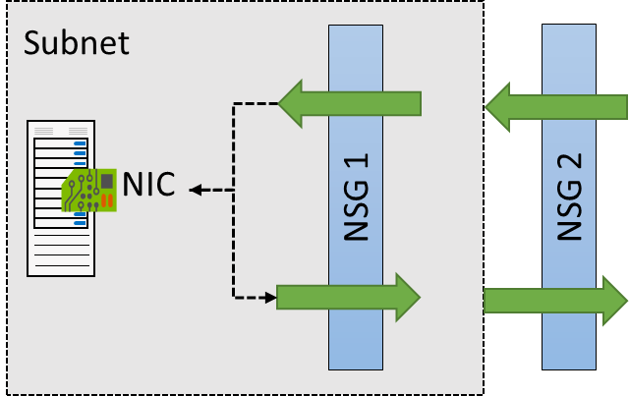
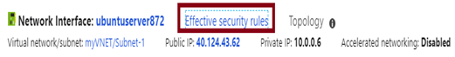
NSG Effective Rules
NSGs are evaluated independently for the subnet and NIC
An “allow” rule must exist at both levels for traffic to be admitted
Use the Effective Rules link if you are not sure which security rules are being applied
Notes:
For more information, you can see:
Azure Network Security Groups (NSG) – Best Practices and Lessons Learned - https://blogs.msdn.microsoft.com/igorpag/2016/05/14/azure-network-security-groups-nsg-best-practices-and-lessons-learned/

Slide 58
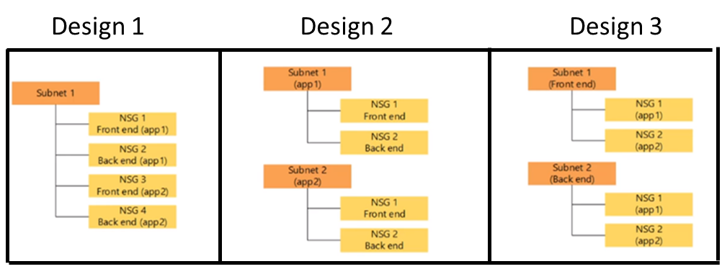
NSG Scenarios
Your subnet designs will affect your NSG associations
For example, let’s assume you have two apps (App1 and App2). Each app has front-end (web servers) and backend (workload) resources
Consider these three designs
Notes:
✔️ Which of these designs do you prefer? Each offers different advantages in the areas of security, isolation, and ease of management.
For more information, you can see:
Azure Network Security Best Practices - https://docs.microsoft.com/en-us/azure/security/azure-security-network-security-best-practices
Networking Limits - https://docs.microsoft.com/en-us/azure/azure-subscription-service-limits?toc=%2fazure%2fvirtual-network%2ftoc.json#networking-limits-1

Slide 59
Lesson 02: Implementing Network Security Groups and Service Endpoints

Slide 60
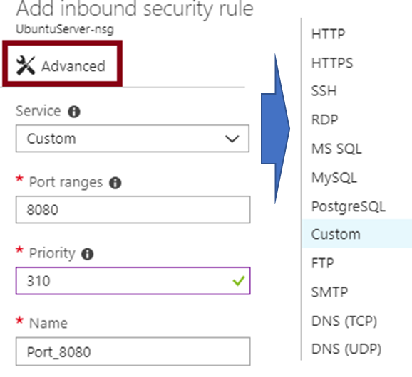
Creating NSG Rules
Select from a large variety of services
Service - The destination protocol and port range for this rule
Port ranges – Single port or multiple ports
Priority - The lower the number, the higher the priority
Notes:
✔️Take a minute to locate the Advanced rule page. Are there any services you are interested in?
For more information, you can see:
Create a security rule - https://docs.microsoft.com/en-us/azure/virtual-network/manage-network-security-group#create-a-security-rule

Slide 61
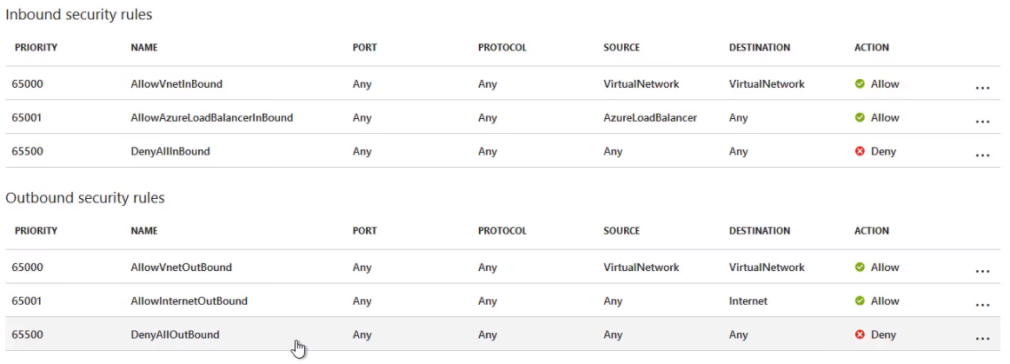
Network Security Groups
Notes:
NSGs - https://www.youtube.com/embed/jt-F5UMM318

Slide 62
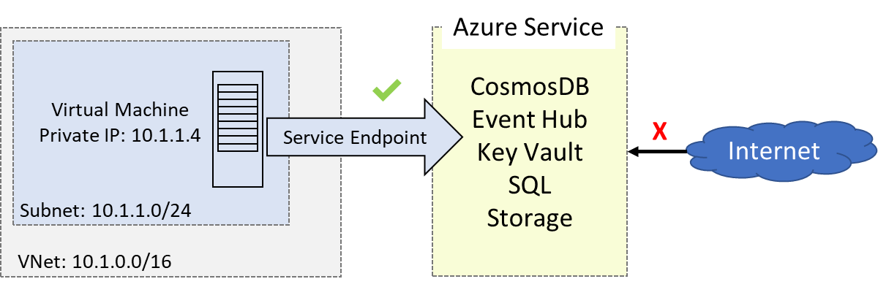
Service Endpoints
Endpoints limit network access to specific subnets and IP addresses
Provides security, optimal routing, and ease of use
Current support: Cosmos DB, Event Hub, Key Vault, SQL, and Storage
Notes:
✔️ Can you see a use for service endpoints in your organization?
For more information, you can see:
Virtual network service endpoints - https://docs.microsoft.com/en-us/azure/virtual-network/virtual-network-service-endpoints-overview
Limitations of network service endpoints - https://docs.microsoft.com/en-us/azure/virtual-network/virtual-network-service-endpoints-overview#limitations

Slide 63
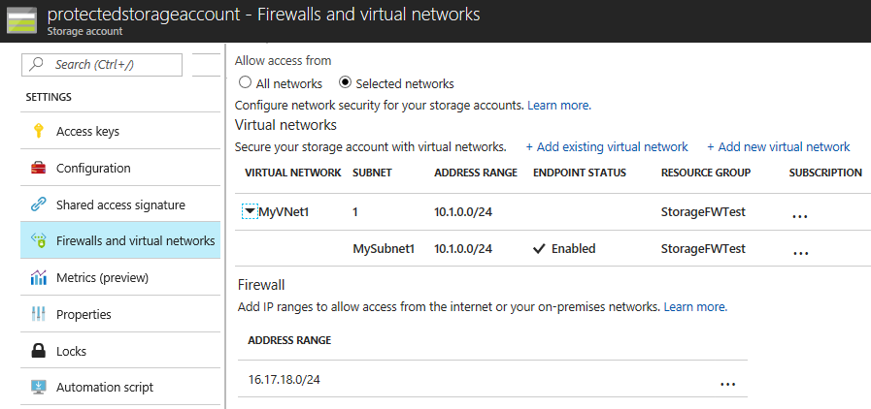
Implementing Service Endpoints
Must configure both sides of the endpoints. For example, the virtual network side and the storage account side.
Steps vary depending on the endpoint service
Notes:
✔️It is important to test and ensure the service endpoint is limiting access as expected. You will do this in the practice exercise.
For more information, you can see:
Virtual Network Service Endpoints and Firewalls for Azure Storage now generally available - https://azure.microsoft.com/en-us/blog/virtual-network-service-endpoints-and-firewalls-for-azure-storage-now-generally-available/
Configure Azure Storage Firewalls and Virtual Networks - https://docs.microsoft.com/en-us/azure/storage/common/storage-network-security

Slide 64
Lab 3A: Service Endpoints
Create a virtual network with one subnet
Add a subnet and enable a service endpoint
Create an Azure resource and allow network access to it from only a subnet
Deploy a virtual machine (VM) to each subnet
Confirm access to a resource from an allowed subnet
Confirm access is denied to a resource from another subnet and the internet
Notes:
Tutorial: Restrict network access to PaaS resources with virtual network service endpoints using the Azure portal - https://docs.microsoft.com/en-us/azure/virtual-network/tutorial-restrict-network-access-to-resources
For more information, you can see:
Restrict network access to PaaS resources with virtual network service endpoints using PowerShell - https://docs.microsoft.com/en-us/azure/virtual-network/tutorial-restrict-network-access-to-resources-powershell
Restrict network access to PaaS resources with virtual network service endpoints using the Azure CLI - https://docs.microsoft.com/en-us/azure/virtual-network/tutorial-restrict-network-access-to-resources-cli

Slide 65
AZ-100.4 Module 04: Connecting Virtual Networks

Slide 66
Lesson 01: Intersite Connectivity

Slide 67
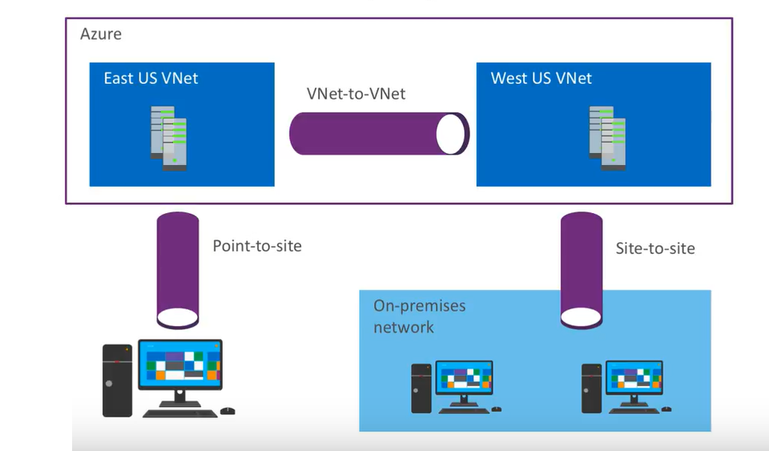
Virtual Network Connectivity
Site-to-Site
Connect an on-premises network to your virtual networks in Azure
VNet-to-VNet
Connect two virtual networks in Azure together
Point-to-Site
Connect an individual machine directly through VPN into an Azure virtual network
Notes:
Virtual Network Connectivity - https://www.youtube.com/embed/4dRiliE_vnQ

Slide 68
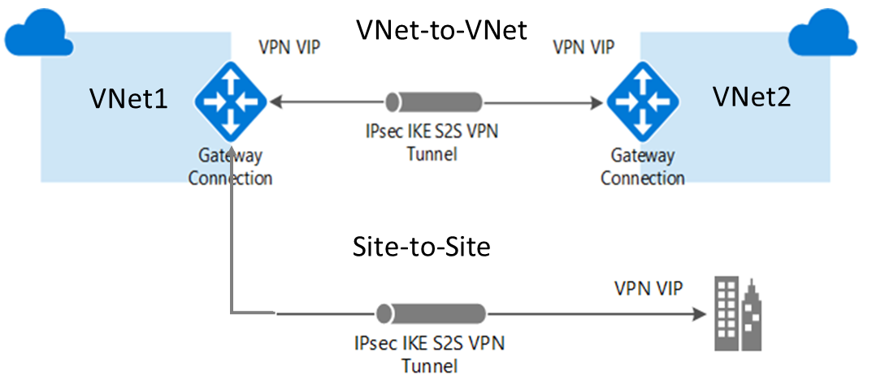
VNet-to-VNet Connections
Connect VNets with a VNet-to-VNet VPN connection
Requires a VPN gateway in each virtual network
A secure IPsec/IKE tunnel provides the communication
Notes:
Point out the gateway on each side. Site-to-Site Connections are covered in the Implementing Advanced Virtual Networking course, Exam AZ-101.
✔️ Can you see how this could be used to create network topologies that combine on-premises and Azure connectivity? Note that the Gateway VPN used here is different from the Gateway subnet used for VNet Peering.
For more information, you can see:
VNet-to-VNet Connectivity - https://docs.microsoft.com/en-us/azure/vpn-gateway/vpn-gateway-howto-vnet-vnet-resource-manager-portal#vnet-to-vnet
Site-to-Site ( IPsec) - https://docs.microsoft.com/en-us/azure/vpn-gateway/vpn-gateway-howto-vnet-vnet-resource-manager-portal#site-to-site-ipsec
About cryptographic requirements and Azure VPN gateways - https://docs.microsoft.com/en-us/azure/vpn-gateway/vpn-gateway-about-compliance-crypto

Slide 69
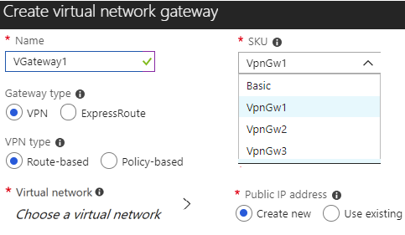
Create VPN Gateways
Each virtual network needs a VPN gateway
Most VPN types are Route-based, select a gateway SKU
The SKU affects the number of tunnels and the throughput
The gateway needs a public IP address
Notes:
✔️Be sure to use the reference link and read more about the VPN gateway configuration. And, continue to the next page for configuring the connections between the VPN gateways.
For more information, you can see:
Create a virtual network gateway - https://docs.microsoft.com/en-us/azure/vpn-gateway/vpn-gateway-howto-vnet-vnet-resource-manager-portal#VNetGateway
VPN Types - https://docs.microsoft.com/en-us/azure/vpn-gateway/vpn-gateway-about-vpn-gateway-settings#vpntype

Slide 70
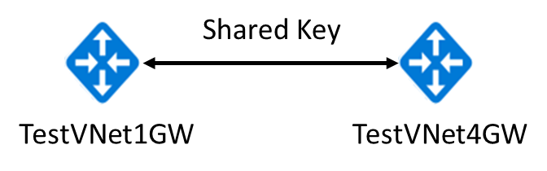
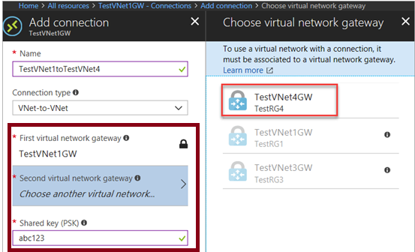
Configuring Gateway Connections
Once your VPN gateways are created, you can create the connection between them.
If your VNets are in the same subscription, you can use the portal.
The shared key provides the connection
Must create the connection for each virtual network
Notes:
✔️ If your VNets are in different subscriptions, you must use PowerShell to make the connection. You can use the New-AzureRmVirtualNetworkGatewayConnection command. This command can also be used for Site-to-Site connections.
For more information, you can see:
Configure the TestVNet1 gateway connection - https://docs.microsoft.com/en-us/azure/vpn-gateway/vpn-gateway-howto-vnet-vnet-resource-manager-portal#TestVNet1Connection

Slide 71
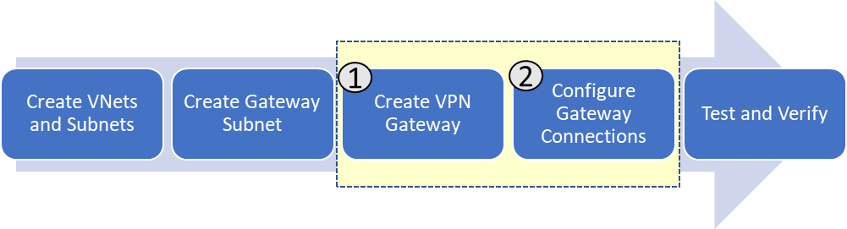
VNet-to-VNet Connections
Notes:
VNet-to-VNet Connections - https://www.youtube.com/embed/85VSGsMMJTo

Slide 72
Lab 4A: VNet-to-VNet Connections
Create and configure virtual networks
Create and configure subnets
Create and configure gateway subnets
Specify a DNS server (optional)
Create and configure virtual network gateways
Configure virtual network gateway connections
Verify your connections
Notes:
Configure a VNet-to-VNet VPN gateway connection using the Azure portal - https://docs.microsoft.com/en-us/azure/vpn-gateway/vpn-gateway-howto-vnet-vnet-resource-manager-portal
For more information, you can see:
Configure a VNet-to-VNet VPN gateway connection using PowerShell - https://docs.microsoft.com/en-us/azure/vpn-gateway/vpn-gateway-vnet-vnet-rm-ps
Configure a VNet-to-VNet VPN gateway connection using Azure CLI - https://docs.microsoft.com/en-us/azure/vpn-gateway/vpn-gateway-howto-vnet-vnet-cli

Slide 73
Lesson 02: Virtual Network Peering

Slide 74
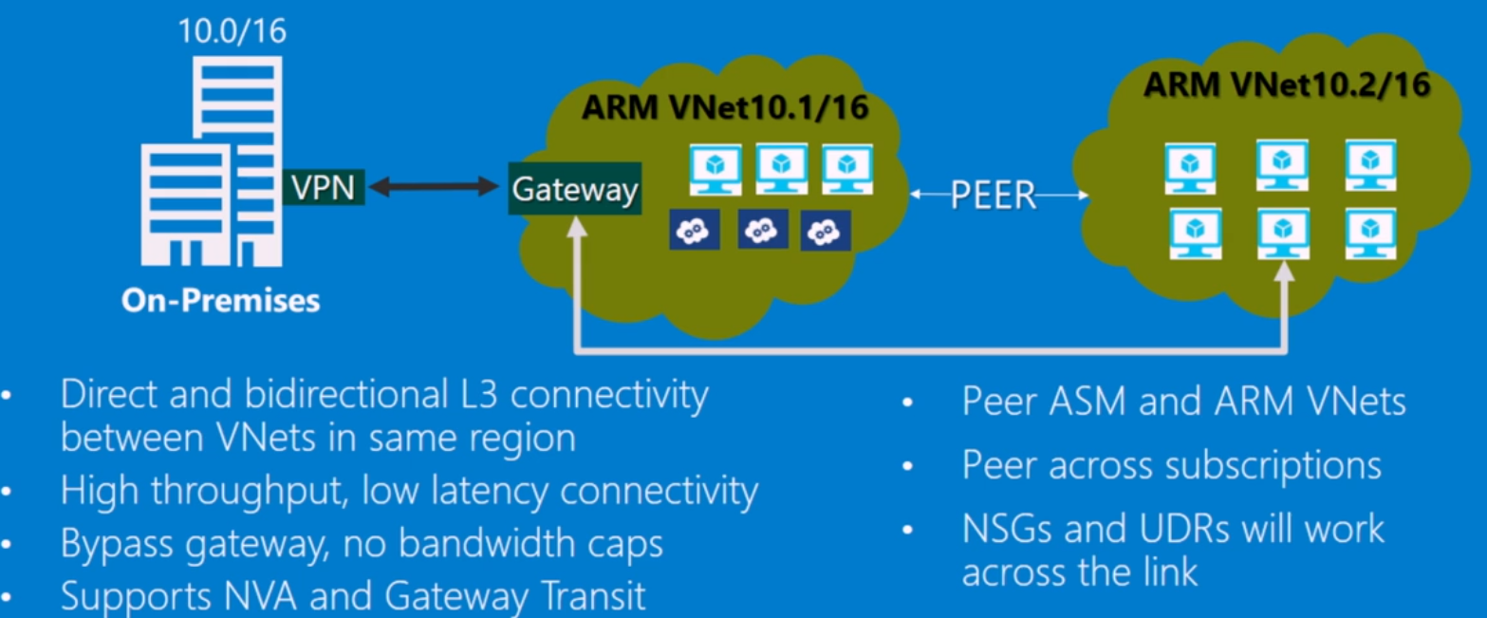
VNet Peering
Notes:
VNet Peering - https://channel9.msdn.com/Shows/Azure-Friday/Virtual-Network-vNet-Peering/player
This is an older Azure Friday’s video. But, it is still very interesting to hear from the Azure Networking team on how they initially conceived of VNet peering and their intentions for its use.

Slide 75
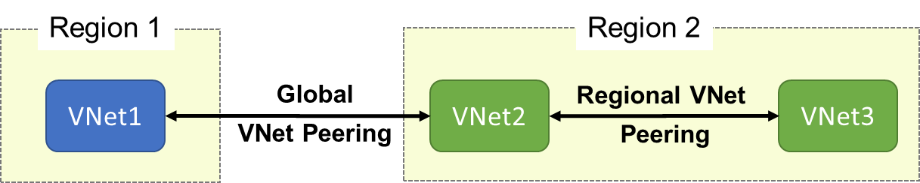
VNet Peering
VNet peering connects two Azure virtual networks (not transient)
Two types of peering: Regional and Global
Peered networks use the Azure backbone for privacy and isolation
Easy to setup, seamless data transfer, and great performance
Notes:
✔️ The default VNet peering configuration provides full connectivity. Can you see how network security groups could be applied to block or deny access to specific subnets or virtual machines?
For more information, you can see:
Virtual network peering - https://docs.microsoft.com/en-us/azure/virtual-network/virtual-network-peering-overview

Slide 76
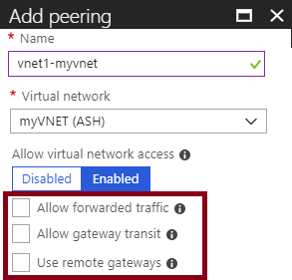
Regional VNet Peering
Allow forwarded traffic from within the peer virtual network into your virtual network.
Allow gateway transit. Allows the peer virtual network to use your virtual network gateway. (upcoming topic)
Use remote gateways. Only one virtual network can have this enabled
Notes:
The gateway option will be discussed in more detail in an upcoming topic.
✔️ Remember If virtual network address spaces overlap, the virtual networks cannot be peered.
For more information, you can see:
Create a peering - https://docs.microsoft.com/en-us/azure/virtual-network/virtual-network-manage-peering#create-a-peering

Slide 77
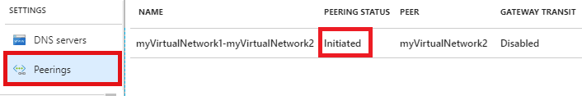
Global VNet Peering
Global VNet peering connects virtual networks across regions
Status will be Initiated or Connected
Special requirements: public clouds only, virtual network resource limitations, no gateway transit, no transitivity, and limitations on high performance virtual machines.
Notes:
For more information, you can see:
How to setup Global VNet peering in Azure - https://blogs.msdn.microsoft.com/azureedu/2018/04/24/how-to-setup-global-vnet-peering-in-azure/
Requirements and constraints - https://docs.microsoft.com/en-us/azure/virtual-network/virtual-network-manage-peering#requirements-and-constraints

Slide 78
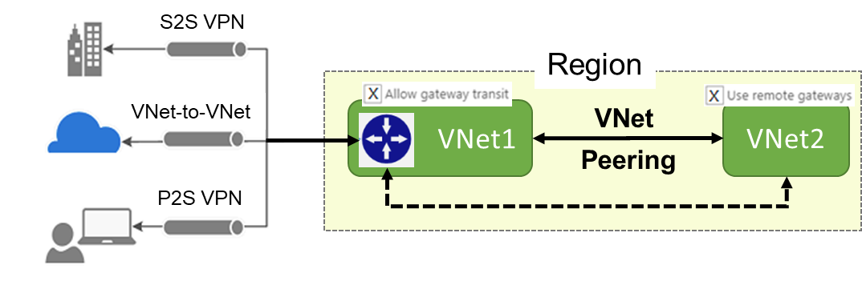
Gateway Transit
Gateway transit allows peered virtual networks to share the gateway and get access to resources.
This means you do not need to deploy a VPN gateway in the peer virtual network.
Notes:
✔️ When working with gateway subnets, avoid associating a network security group (NSG) to the gateway subnet. Associating a network security group to this subnet may cause your VPN gateway to stop functioning as expected.
For more information, you can see:
Gateway transit - https://docs.microsoft.com/en-us/azure/vpn-gateway/vpn-gateway-peering-gateway-transit?toc=%2fazure%2fvirtual-network%2ftoc.json
PowerShell Example - https://docs.microsoft.com/en-us/azure/vpn-gateway/vpn-gateway-peering-gateway-transit?toc=%2fazure%2fvirtual-network%2ftoc.json#powershell-sample
Hub and spoke - https://docs.microsoft.com/en-us/azure/architecture/reference-architectures/hybrid-networking/hub-spoke
Gateway Subnet - https://docs.microsoft.com/en-us/azure/vpn-gateway/vpn-gateway-about-vpn-gateway-settings#gwsub

Slide 79
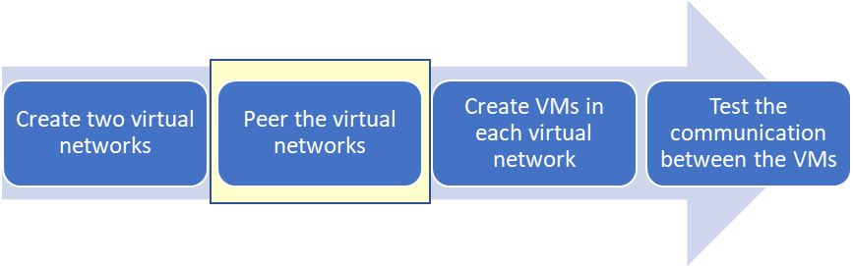
VNet Peering
Notes:
VNet Peering - https://www.youtube.com/embed/IfHUgnvd6VA
At the time of this video Global VNet peering was in Preview. It is now generally available in all Azure public regions.
For more information, you can see:
Global VNet Peering now generally available - https://azure.microsoft.com/en-us/blog/global-vnet-peering-now-generally-available

Slide 80
Lab 4B: VNet Peering
Create two virtual networks
Connect two virtual networks with a virtual network peering
Deploy a VM into each virtual network
Test the communication between the VMs
Notes:
Tutorial: Connect virtual networks with virtual network peering using the Azure portal - https://docs.microsoft.com/en-us/azure/virtual-network/tutorial-connect-virtual-networks-portal
For more information, you can see:
Connect virtual networks with virtual network peering using PowerShell - https://docs.microsoft.com/en-us/azure/virtual-network/tutorial-connect-virtual-networks-powershell
Connect virtual networks with virtual network peering using the Azure CLI - https://docs.microsoft.com/en-us/azure/virtual-network/tutorial-connect-virtual-networks-cli

